Slide 1
Morphogenesis and organogenesis
Morphogenetic determinants and their role in development

Slide 2
Morphogenetic determinants Axis and pattern formation in Drosophila

Slide 3
Morphogenesis
Three broad interrelated processes are involved in building an embryo.
1. Cell division
2. Cell differentiation.
3. Morphogenesis.

Slide 4
Morphogenesis
Five major questions:
How are tissues formed from populations of cells?
How are organs constructed from tissues?
How do organs form in particular locations, and how do migrating cells reach their destinations?
How do organs and their cells grow, and how is their growth coordinated throughout development?
How do organs achieve polarity?
Notes:
There are five major questions for embryologists who study morphogenesis:
1.How are tissues formed from populations of cells? For example, how do neural retina cells stick to other neural retina cells and not become integrated into the pigmented retina or iris cells next to them? How are the various cell types within the retina (the three distinct layers of photoreceptors, bipolar neurons, and ganglion cells) arranged so that the retina is functional?
2.How are organs constructed from tissues? The retina of the eye forms at a precise distance behind the cornea and the lens. The retina would be useless if it developed behind a bone or in the middle of the kidney. Moreover, neurons from the retina must enter the brain to innervate the regions of the brain cortex that analyze visual information. All these connections must be precisely ordered.
3.How do organs form in particular locations, and how do migrating cells reach their destinations? Eyes develop only in the head and nowhere else. What stops an eye from forming in some other area of the body? Some cells—for instance, the precursors of our pigment cells, germ cells, and blood cells—must travel long distances to reach their final destinations. How are cells instructed to travel along certain routes in our embryonic bodies, and how are they told to stop once they have reached their appropriate destinations?
4.How do organs and their cells grow, and how is their growth coordinated throughout development? The cells of all the tissues in the eye must grow in a coordinated fashion if one is to see. Some cells, including most neurons, do not divide after birth. In contrast, the intestine is constantly shedding cells, and new intestinal cells are regenerated each day. The mitotic rate of this tissue must be carefully regulated. If the intestine generated more cells than it sloughed off, it could produce tumorous outgrowths. If it produced fewer cells than it sloughed off, it would soon become nonfunctional. What controls the rate of mitosis in the intestine?
5.How do organs achieve polarity? If one were to look at a cross section of the fingers, one would see a certain organized collection of tissues—bone, cartilage, muscle, fat, dermis, epidermis, blood, and neurons. Looking at a cross section of the forearm, one would find the same collection of tissues. But they are arranged very differently in different parts of the arm. How is it that the same cell types can be arranged in different ways in different parts of the same structure?

Slide 5
Morphogenesis
Questions:
How cells receive information about where they are in the embryo?
and
How such positional information can influence differentiation.
How the organism takes on a three dimensional shape with all the cells types in the right place to form structures and carry out functions.

Slide 6
Morphogenesis
Refers to how the organism and its parts are shaped.
Morphogenesis in animals involves specific changes in cell shape, position, and adhesion
Pattern formation: The development of a spatial organisation in which the cells, tissues and organs are all in characteristic places.
Morphogenesis is the outcome of correct pattern formation.
Arrangement of cells in a pattern.

Slide 7
Morphogenesis
Two major types of cell arrangements in the embryo:
epithelial cells: are tightly connected to one another in sheets or tubes,
mesenchymal cells: are unconnected to one another and operate as independent units.

Slide 8
Morphogenesis
Morphogenesis occurs through a limited repertoire of variations in cellular processes within these two types of arrangements:
(1) the direction and number of cell divisions
(2) cell shape changes
(3) cell movement
(4) cell growth
(5) cell death, and
(6) changes in the composition of the cell membrane or secreted products.

Slide 9
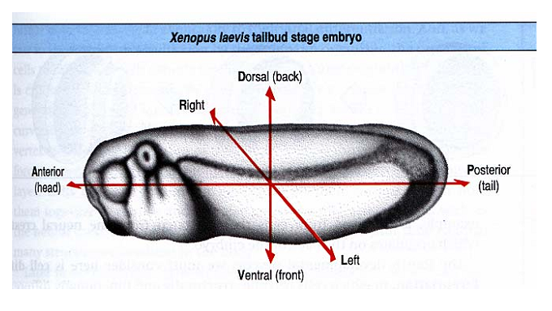
Positional information: information (molecular signals and cues) that indicates their relative positions within the embryo.
So positional information is the molecular signals and cues experienced by the cells according to position.

Slide 10
Morphogenesis could be organised by cells receiving information about their relative positions within the embryo according to such co-ordinates.
Two possible ways in which cells can receive positional information:
1. Localisation of cytoplasmic determinants
2. Induction

Slide 11
What’s so great about the fruit fly Drosophila?
small and easily grown in the laboratory.
generation time of only two weeks and produces many offspring.
Embryos develop outside the mother’s body.
vast amounts of information on its genes and other aspects of its biology.
Copyright © 2002 Pearson Education, Inc., publishing as Benjamin Cummings

Slide 12
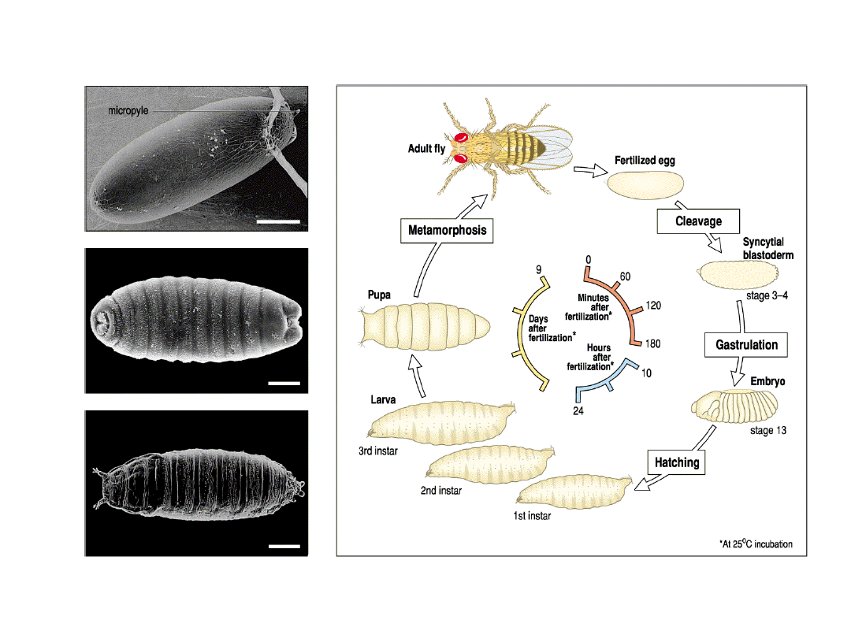
Life cycle of Drosophila melanogaster

Slide 13
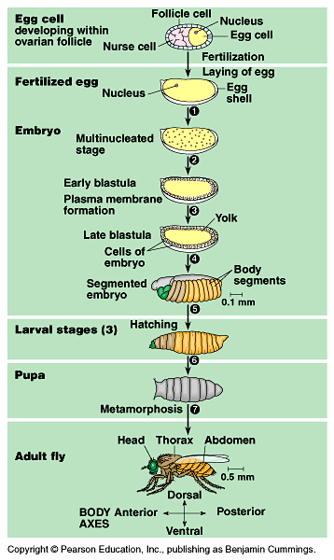
Early Drosophila Development

Slide 14
Anterior-Posterior axis pattern formation in Drosophila
The A/P axis found to be patterned before the nuclei even begin to function.
The nurse cells of the ovary deposit mRNAs in the developing oocyte, and these mRNAs are apportioned to different regions of the cell.
In particular, four maternal messenger RNAs are critical to the formation of the anterior-posterior axis:
bicoid and hunchback mRNAs, whose protein products are critical for head and thorax formation
nanos and caudal mRNAs, whose protein products are critical for the formation of the abdominal segments

Slide 15
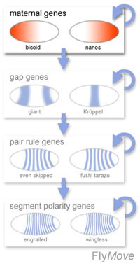
Anterior-Posterior axis pattern formation in Drosophila
Maternal genes:
• Maternal genes establish the body axes.
• Maternal gene products, mRNAs and proteins are
expressed in the ovary.
• Zygotic genes are expressed by the embryo.
• Zygotic genes respond to maternal gene expression.
• First broad regions are established, then smaller domains
(with a unique set of zygotic gene activities) in a hierarchy
of gene activity.

Slide 16
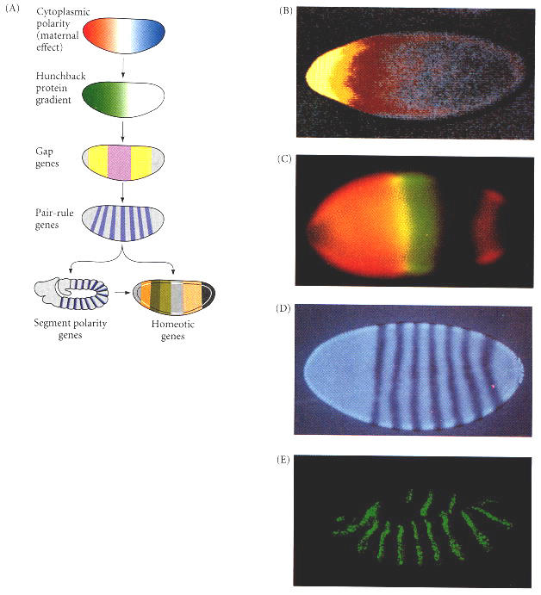
Drosophila development: maternal genes
bicoid is sequestered in the oocyte during oogenesis.
bicoid sets up a A/P morphogenic gradient and controls the first steps in embryo development.
bicoid mRNA is localized to the anterior end of the unfertilized egg.
After fertilization, the mRNA is translated and a concentration gradient is formed along the A/P axis.
(bicoid was the first evidence of a morphogen gradient.)
Notes:
Generalized model of Drosophila anterior-posterior pattern formation. (A) The pattern is established by maternal effect genes that form gradients and regions of morphogenetic proteins. These morphogenetic determinants create a gradient of Hunchback protein that differentially activates the gap genes, which define broad territories of the embryo. The gap genes enable the expression of the pair-rule genes, each of which divides the embryo into regions about two segments wide. The segment polarity genes then divide the embryo into segment-sized units along the anterior-posterior axis. Together, the actions of these genes define the spatial domains of the homeotic genes that define the identities of each of the segments. In this way, periodicity is generated from nonperiodicity, and each segment is given a unique identity. (B) Maternal effect genes. The anterior axis is specified by the gradient of Bicoid protein (yellow through red). (C) Gap gene protein expression and overlap. The domain of Hunchback protein (orange) and the domain of Krüppel protein (green) overlap to form a region containing both transcription factors (yellow). (D) Products of the fushi tarazu pair-rule gene form seven bands across the embryo. (E) Products of the segment polarity gene engrailed, seen here at the extended germ band stage. (B courtesy of C. Nüsslein-Vollhard; C courtesy of C. Rushlow and M. Levine; D courtesy of T. Karr; E courtesy of S. Carroll and S. Paddock.)

Slide 17
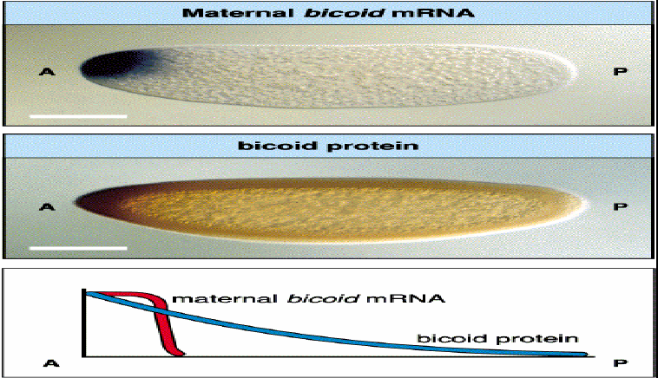
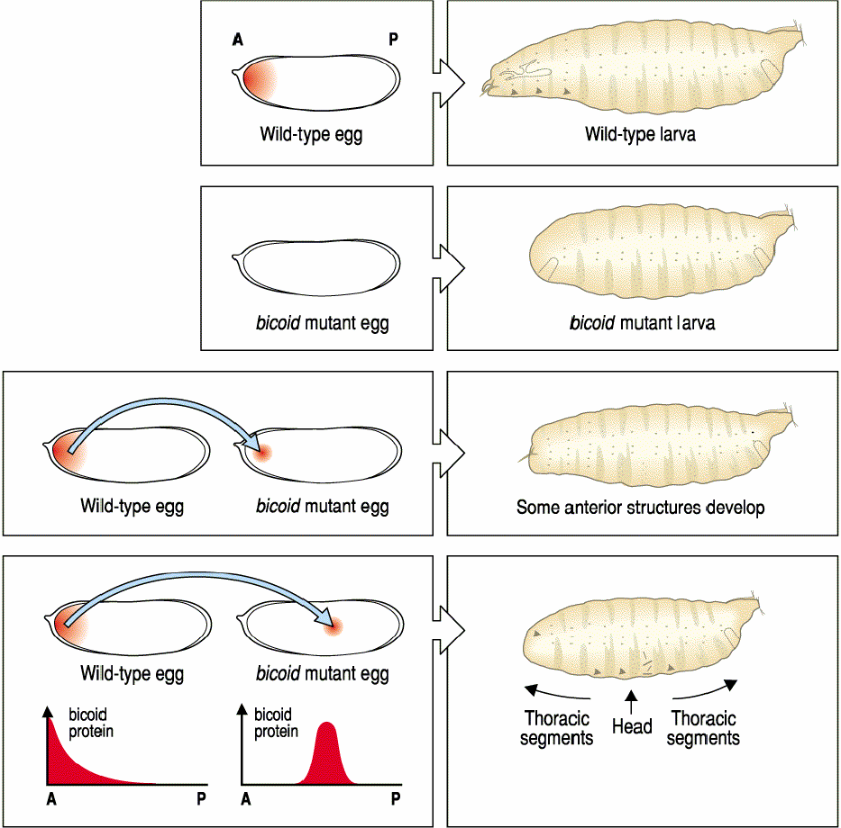

Slide 18
The molecular model: protein gradients in the early embryo
In late 1980s: the gradient hypothesis with genetic approach:
If there were gradients, what were the morphogens whose concentrations changed over space?
What were the genes that shaped these gradients? And
did these morphogens act by activating or inhibiting certain genes in the areas where they were concentrated?
Three independent genetic pathways interact to form the anterior-posterior axis of the Drosophila embryo.
In each case, the initial asymmetry is established during oogenesis, and the pattern is organized by maternal proteins soon after fertilization.

Slide 19
The molecular model: protein gradients in the early embryo
Christiane Nüsslein-Volhard and group found that
one set of genes encoded gradient morphogens for the anterior part of the embryo,
another set of genes encoded morphogens responsible for organizing the posterior region of the embryo, and
a third set of genes encoded proteins that produced the terminal regions at both ends of the embryo.
Nobel Prize: Christiane Nüsslein-Volhard and her colleague, Eric Wieschaus, in 1995.

Slide 20
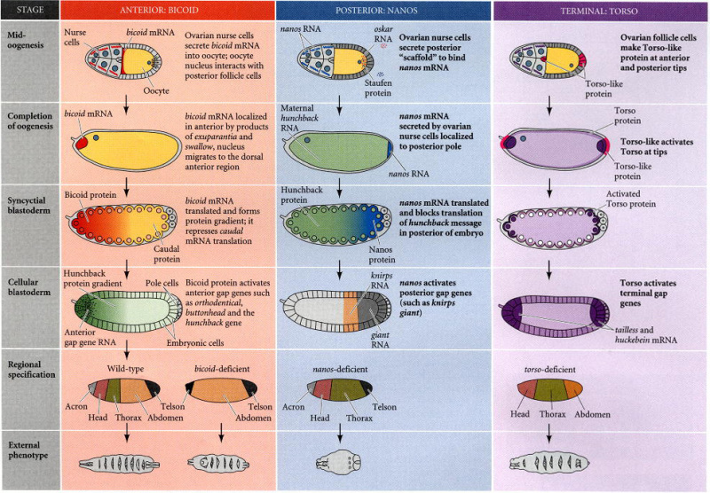
The molecular model: protein gradients in the early embryo

Slide 21
Maternal genes that affect the anterior-posterior polarity of the Drosophila embryo
Gene | Mutant phenotype | Proposed function and structure
Anterior Group
bicoid (bcd) | Head and thorax deleted, replaced by inverted telson | Graded anterior morphogen; contains homeodomain; represses caudal
exuperantia (exu) | Anterior head structures deleted | Anchors bicoid mRNA
swallow (swa) | Anterior head structures deleted | Anchors bicoid mRNP
Posteriro Group
nanos (nos) | No abdomen | Posterior morphogen; represses hunchback
tudor (tud) | No abdomen, no pole cells | Localization of Nanos
oskar (osk) | No abdomen, no pole cells | Localization of Nanos
vasa (vas) | No abdomen, no pole cells; oogenesis defective | Localization of Nanos
valois (val) | No abdomen, no pole cells; cellularization defective | Stabilization of the Nanos localization complex
pumilio (pum) | No abdomen | Helps Nanos protein bind hunchback message
caudal (cad) | No abdomen | Activates posterior terminal genes
Terminal Group
torso (tor) | No termini | Possible morphogen for termini
trunk (trk) | No termini | Transmits Torsolike signal to Torso
fs(1)Nasrat[fs(1)N] | No termini; collapsed eggs | Transmits Torsolike signal to Torso
fs(1)polehole[fs(1)ph] | No termini; collapsed eggs | Transmits Torsolike signal to Torso

Slide 22
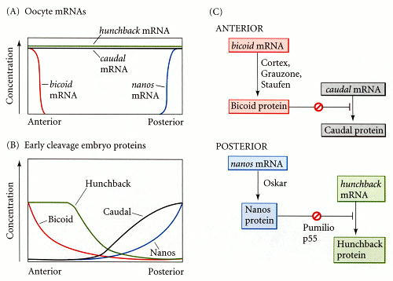
A model of A/P axis pattern formation by the maternal genes.

Slide 24
